Slide 1
Network Automation
SDN Load Balancing
Name of the project: SDN Load Balancing
Group Name: BGG
Presenters: Enrico Gregorini, Mattia Bevilacqua, Daniele Gjeka
Academic Year: 2022/2023

Slide 2
Agenda
Introduction
Project objectives
Implementation
Flow charts of the project with and without the testbed
Experiments
Description of the experiments (included the testbed setup)
Results and demo
Description of the results obtained by the project implementation
Notes:
D

Slide 3
Introduction: Project Objectives
1 - Design different size multipath network topologies with multiple paths from one switch to another using Mininet environment.
2 - Measure the traffic on the links in real time by using OpenFlow functions
OFPPortStatsRequest
EventOFPPortStatsReply
3 - Implement a load balancing algorithm to balance the traffic through the links by their usage as weight
NetworX library, in particular, dijkstra_path returning the shortest weighted path
Notes:
D

Slide 4
Introduction: Project Objectives
4 - Test the algorithm using two different traffic generators
5 - Display the results by plotting a graph that shows the decrease of the total load in the network with the load balancer
D-itg
Iperf3
6 - Implement the algorithm into the BONSAI SDN testbed
Notes:
D

Slide 5
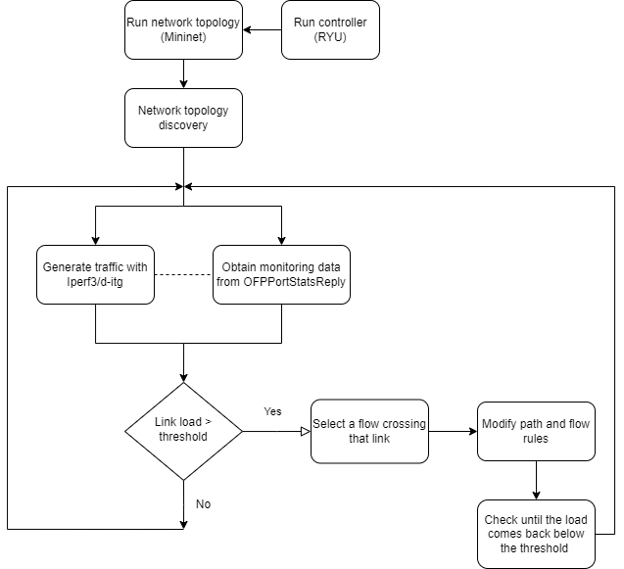
Implementation - RYU + Mininet
Notes:
D

Slide 6
Scripts to automate benchmarks
All scripts use the "m" utility of Mininet to attach to a host and run a command
Both iPerf3 and D-ITG have a server/client component
Server scripts will:
With a for cycle, start a server on every host listed in the script's arguments
Once benchmark is done (or SIGINT received), kill all iPerf3/D-ITG server processes
Client scripts will, with a for cycle, simply start the clients and initiate the benchmark. Duration can be specified in the arguments.
ubuntu@ubuntu:~/sdn-load-balancing$ sudo ./iperf_client.sh 30 2 h3 1 h4 2
Connecting to host 10.0.0.1, port 5201
[ 7] local 10.0.0.3 port 56492 connected to 10.0.0.1 port 5201
Connecting to host 10.0.0.2, port 5201
[ 7] local 10.0.0.4 port 44782 connected to 10.0.0.2 port 5201
[ ID] Interval Transfer Bitrate Retr Cwnd
[ 7] 0.00-30.00 sec 105 MBytes 29.2 Mbits/sec 0 89.1 KBytes
- - - - - - - - - - - - - - - - - - - - - - - - -
[ ID] Interval Transfer Bitrate Retr
[ 7] 0.00-30.00 sec 105 MBytes 29.2 Mbits/sec 0 sender
[ 7] 0.00-30.01 sec 104 MBytes 29.0 Mbits/sec receiver
iperf Done.
[ ID] Interval Transfer Bitrate Retr Cwnd
[ 7] 0.00-30.00 sec 106 MBytes 29.7 Mbits/sec 0 112 KBytes
- - - - - - - - - - - - - - - - - - - - - - - - -
[ ID] Interval Transfer Bitrate Retr
[ 7] 0.00-30.00 sec 106 MBytes 29.7 Mbits/sec 0 sender
[ 7] 0.00-30.01 sec 106 MBytes 29.6 Mbits/sec receiver
iperf Done.
D-ITG
**************** TOTAL RESULTS ****************** __________________________________________________________ Number of flows = 1 Total time = 1.999493 s Total packets = 1448 Minimum delay = 0.000000 s Maximum delay = 0.000000 s Average delay = 0.000000 s Average jitter = 0.000000 s Delay standard deviation = 0.000000 s Bytes received = 724000 Average bitrate = 2896.734322 Kbit/s Average packet rate = 724.183581 pkt/s Packets dropped = 0 (0.00 %) Average loss-burst size = 0 pkt Error lines = 0
Notes:
M

Slide 7
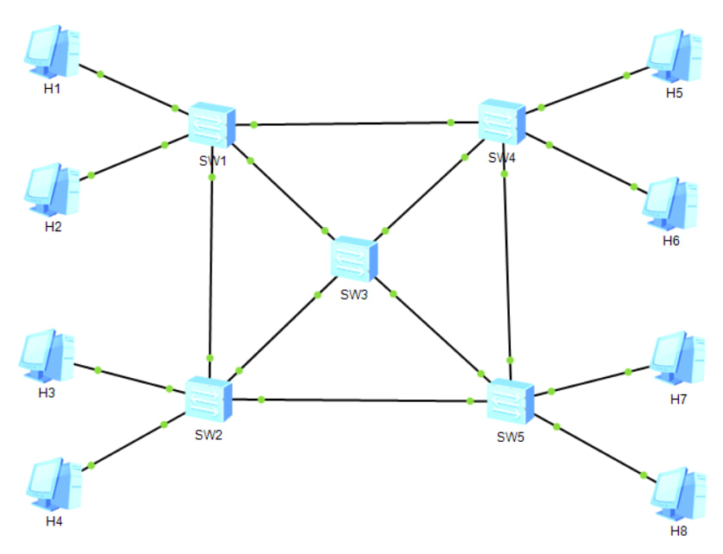
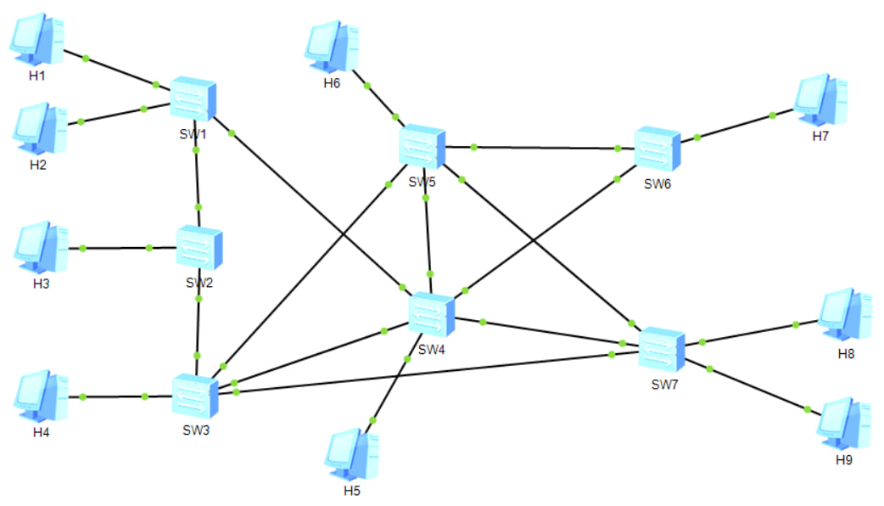
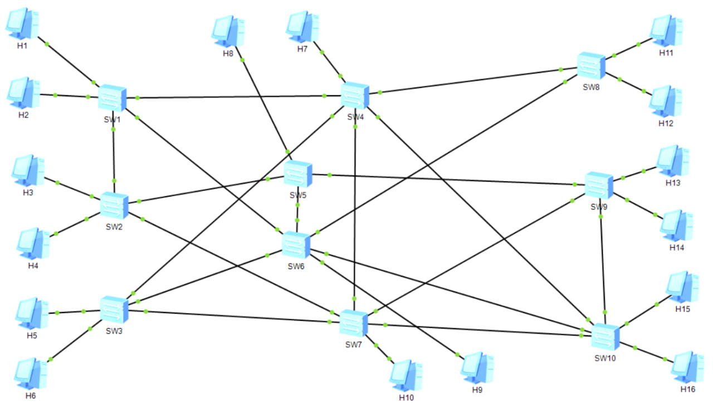
Experiments: Mininet topologies and traffic
Topology 1
5 switches, 8 hosts, 16 100Mbps links
Iperf3: 4 client, 4 servers, simulation time: 60 s
D-ITG: 4 client, 4 servers, simulation time: 60 s
Parameters: Monitoring interval = 1 [s], link utilization threshold = 70%
Topology 2
7 switches, 9 hosts, 20 100Mbps links
Iperf3: 5 client, 5 servers, simulation time: 60 s
D-ITG: 5 client, 5 servers, simulation time: 60 s
Parameters: Monitoring interval = 1 [s], link utilization threshold = 70%
Topology 3
16 switches, 10 hosts, 33 100Mbps links
Iperf3: 8 client, 8 servers, simulation time: 60 s
D-ITG: 8 client, 8 servers, simulation time: 60 s
Parameters: Monitoring interval = 1 [s], link utilization threshold = 70%
Notes:
M

Slide 8
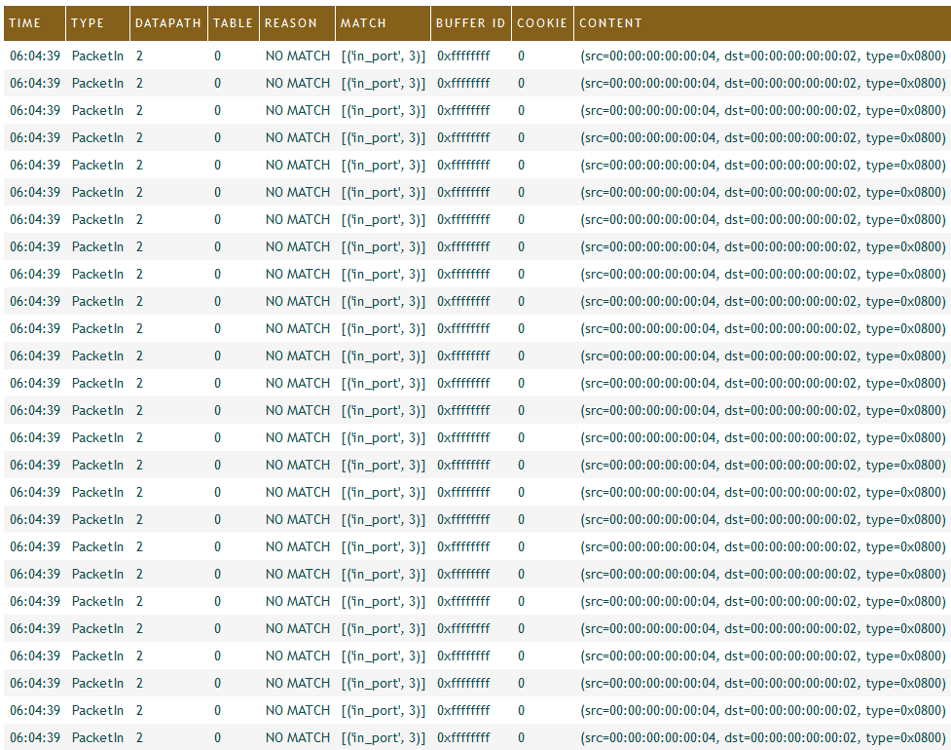
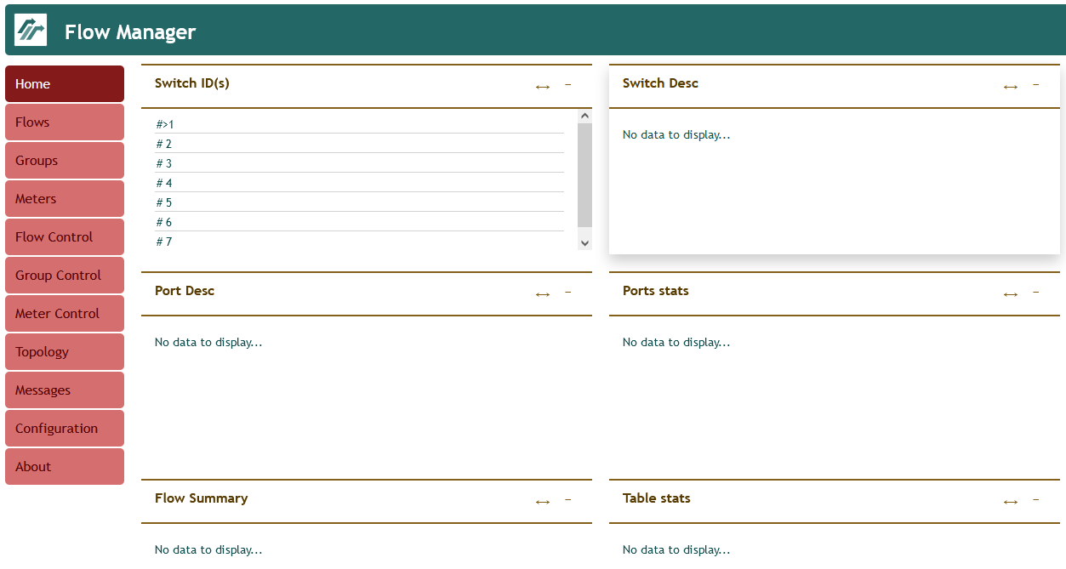
Major roadblock encountered – controller crashing?
Possible causes:
❌ Controller can't handle high traffic/OpenFlow 1.3 bug
❌ PacketIn too complex/resource intensive
❌ Flow rules not updating fast enough
✔️ Flow rules not updated in the correct order: need to start updating rules from last switch in path, towards first switch.
Notes:
M

Slide 9
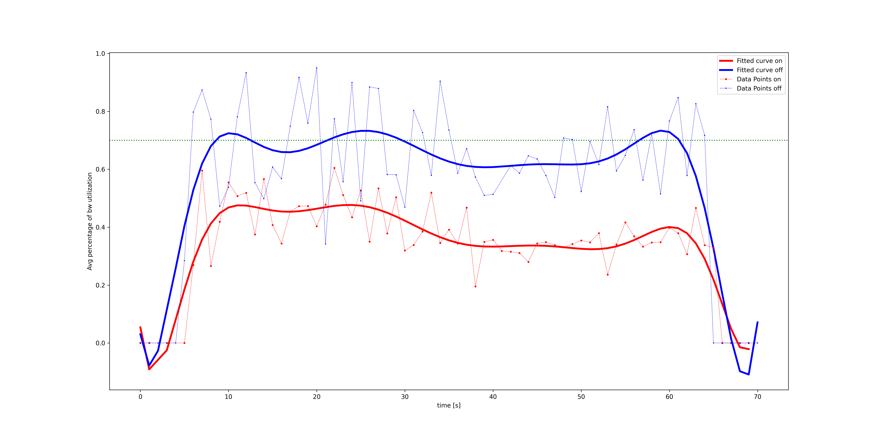
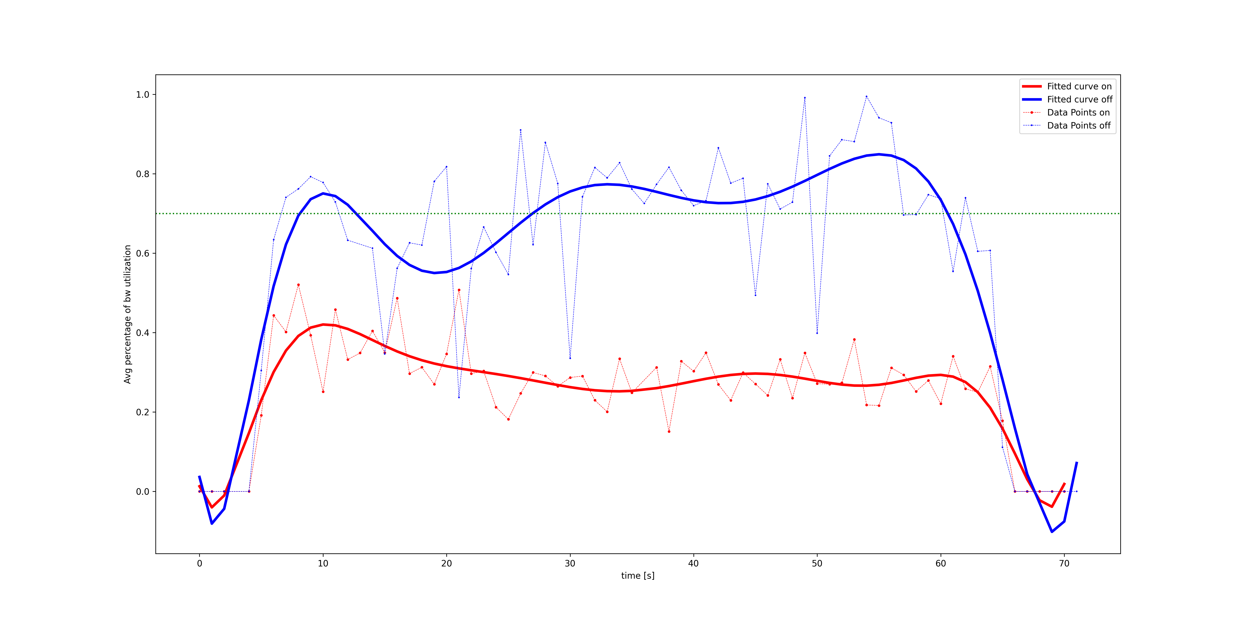
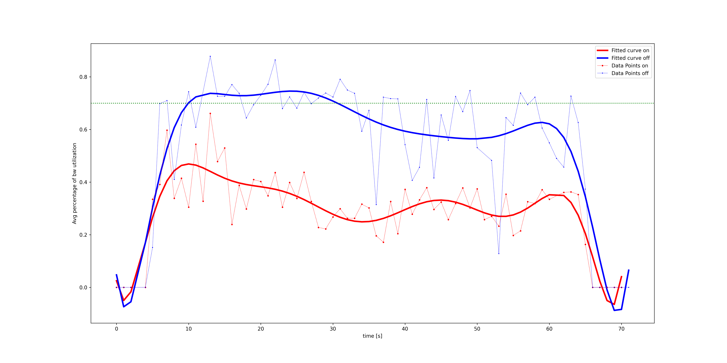
Results - iperf
Notes:
M

Slide 10
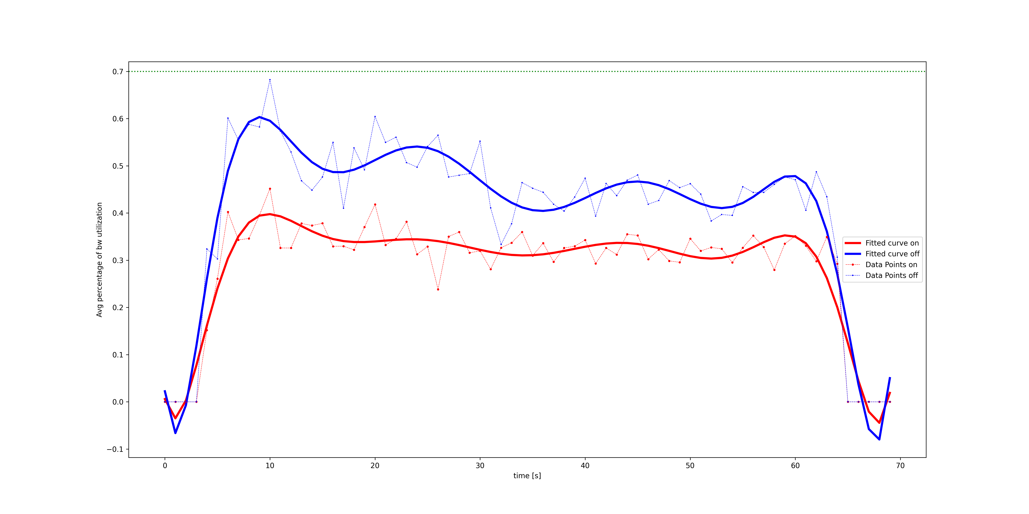
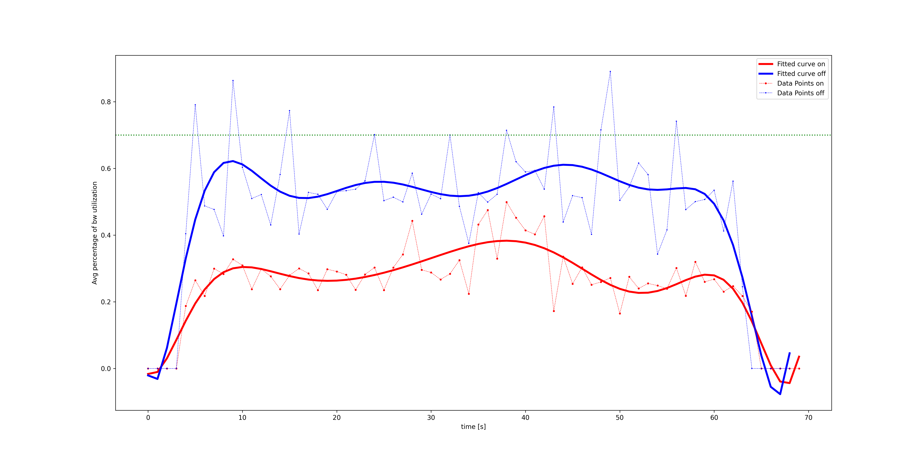
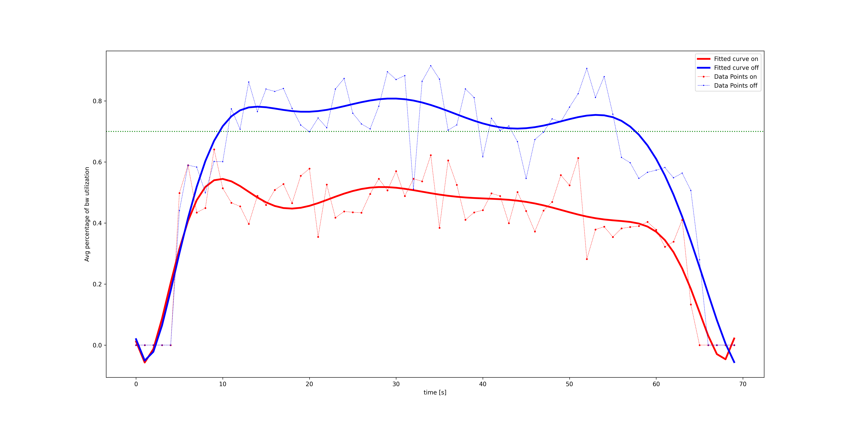
Results – d-itg
Notes:
M

Slide 11
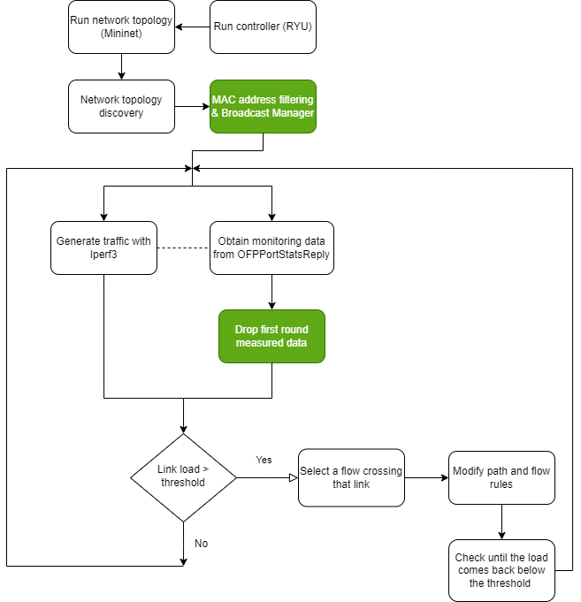
Implementation - testbed
Notes:
E

Slide 12
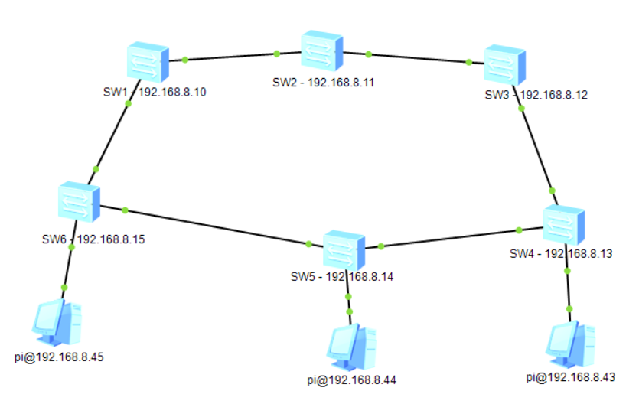
Experiments: testbed
Testbed topology
6 switches, 3 hosts, 9 100Mbps links
Iperf3: 2 client, 1 servers, simulation time: 70 s
Parameters: Monitoring interval = 2 [s], link utilization threshold = 70%
Notes:
E

Slide 13
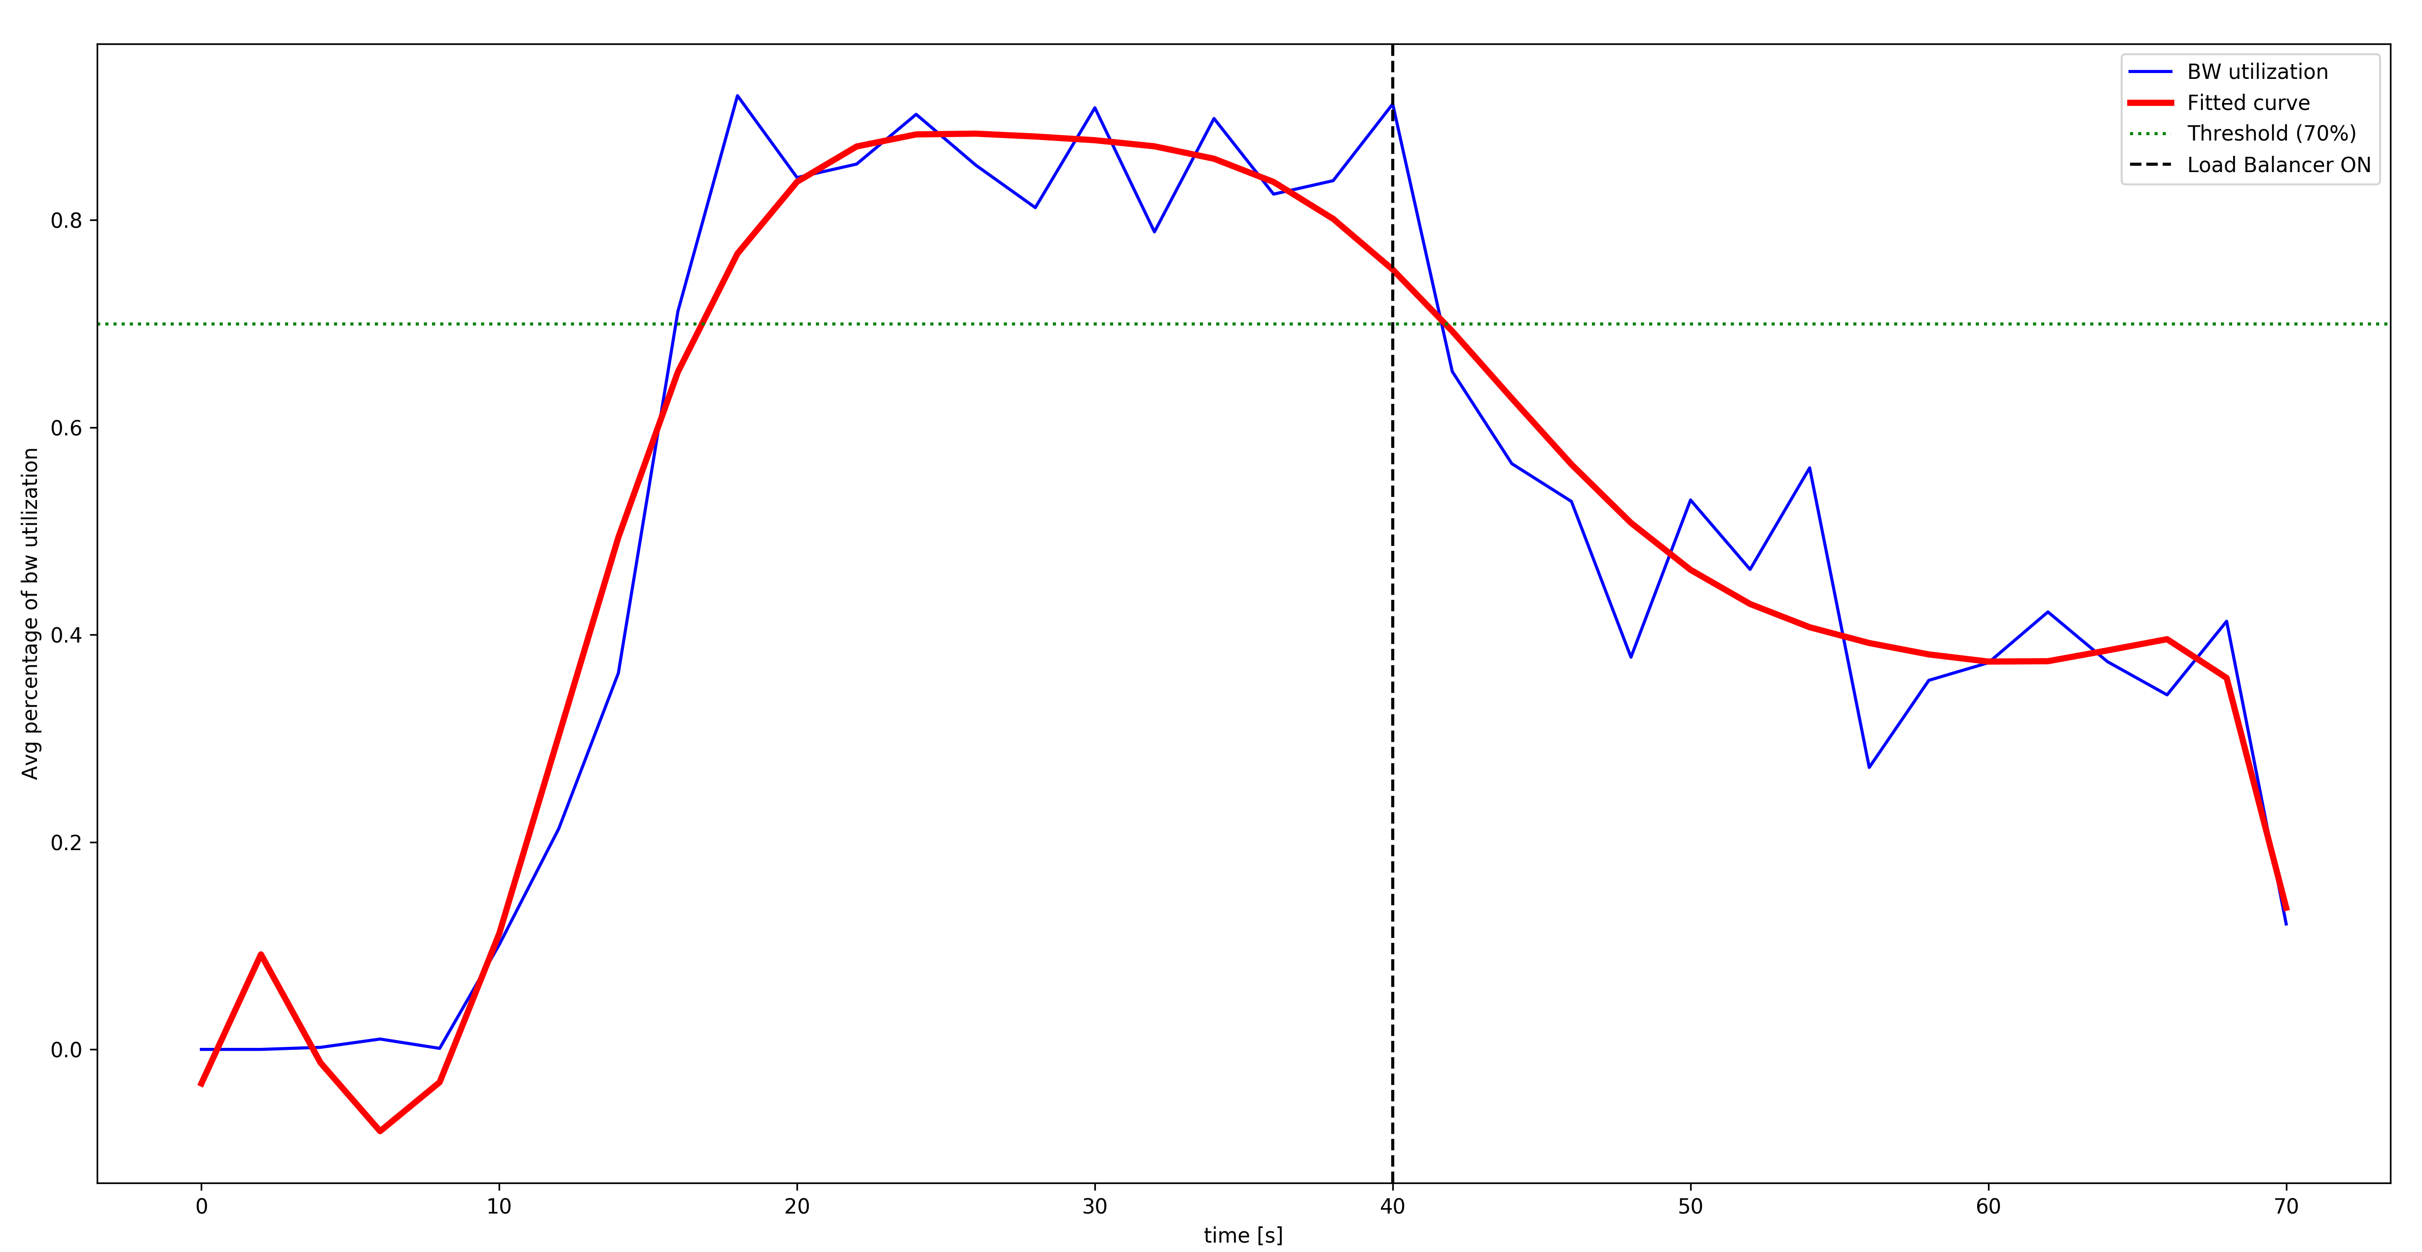
Results – testbed
Results obtained using iPerf3 as traffic generator
Only a single simulation: initially without balancing the traffic, then load balancer turned ON after 40 [s].
Notes:
E

Slide 14

Demo - mininet
Notes:
D+E

Slide 15

Demo – lab testbed
Notes:
E

Slide 16
Lessons learned from testbed
There may be unexpected types of traffic generated by real machines (IPv6 packets, Avahi/mDNS traffic).
Rebooting physical switches is more time consuming than virtual ones.
Switch stats don't start from 0, because switch might've been online for long time.
Links may have different capacity.
Hosts may be less powerful and not able to generate enough traffic.
There may be unexpected hosts not included in a predefined topology (e.g. wireless clients).
Python code must be adapted to make it work properly
e.g. use the correct version of Python
Troubleshooting in real testbeds is critical to obtain good results
Notes:
E

Slide 17
THANK YOU
Enrico Gregorini, Mattia Bevilacqua, Daniele Gjeka

